Slide 1

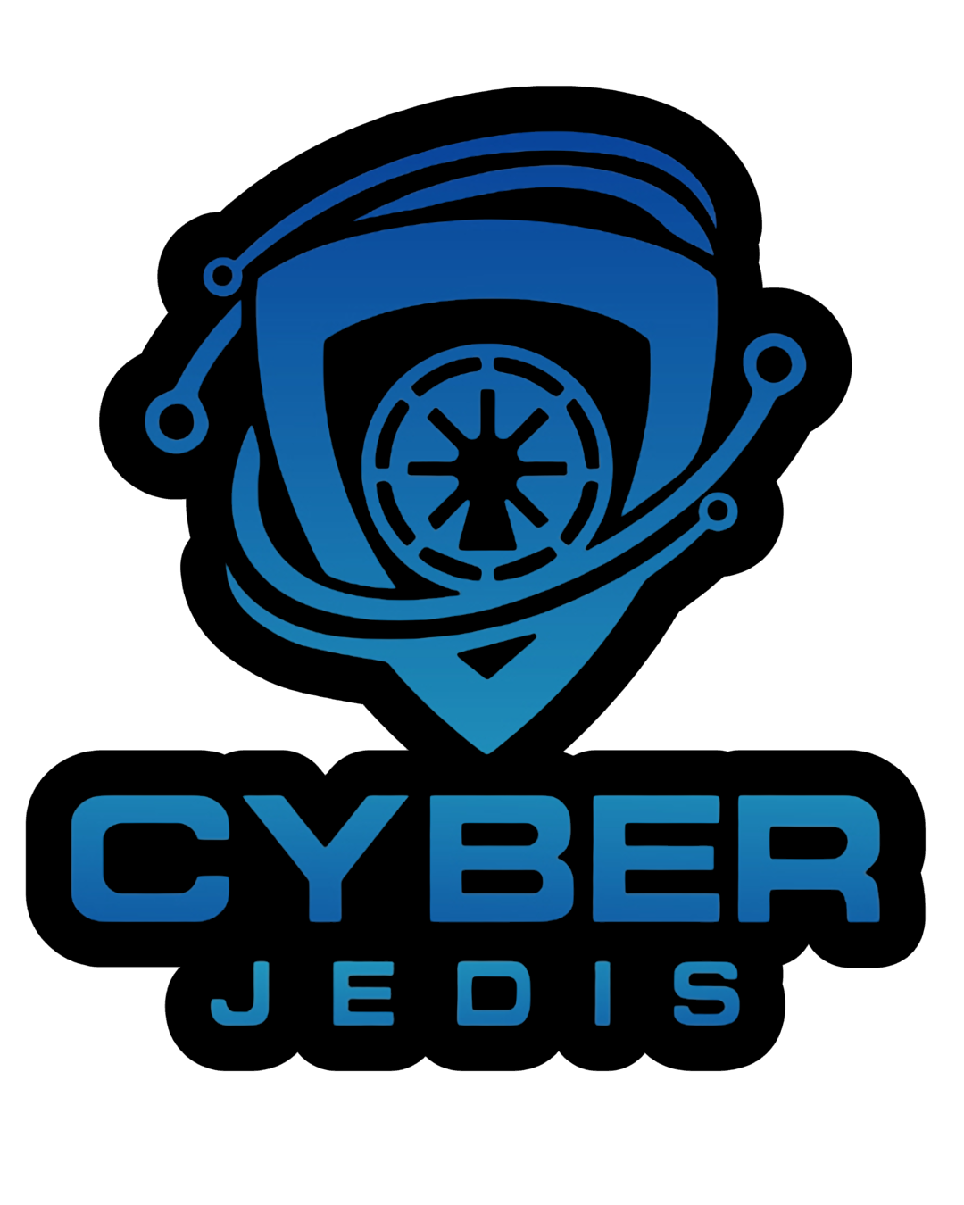
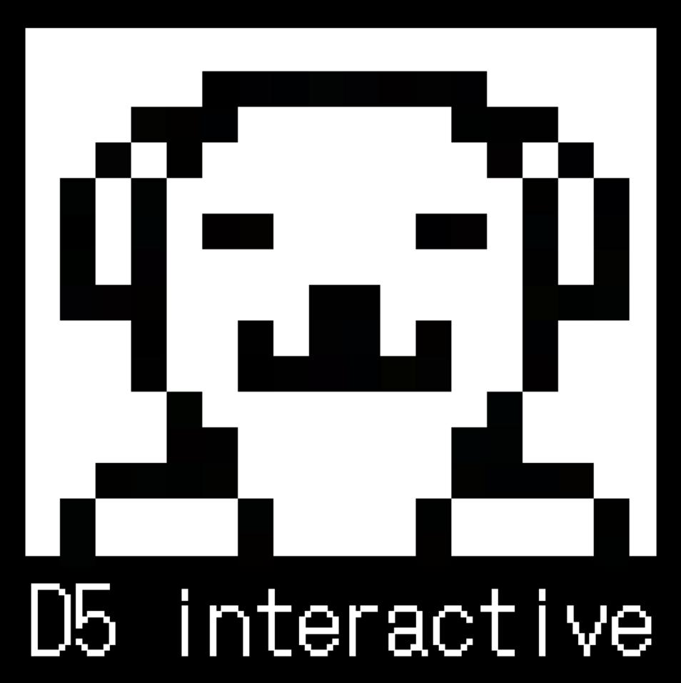
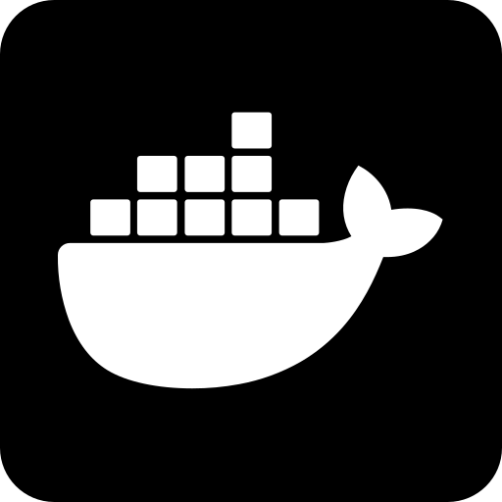
INTRO TO DOCKER
Presented by Walker Caskey (@DSiENT), Cyber Jedis Administrative Director & D5-Interactive Director
Notes:
Today we’ll go from zero to a running Docker container. By the end you’ll understand why Docker exists, how to use it from the command line, and you’ll build a custom image for a Markdown note-taking app that you can extend for your own projects.

Slide 2
The Problem Docker Solves
“Well it works on my machine!”
Different OS versions, Missing libraries, Conflicting dependencies
Virtual machines are HEAVY, each requires a full OS
Notes:
How many of you have had code work on your laptop but fail on a friend’s machine or on a lab computer? Docker was created to solve exactly that. Before containers, the main alternative was virtual machines—but VMs duplicate an entire operating system, which is slow and resource-heavy.

Slide 3
What Is Docker?
Docker is an open platform for developing, shipping, and running applications in containers.
Packages your app and its dependencies into one portable unit
Runs the same way on your laptop, a lab machine, or the cloud
“Build once, run anywhere”
Notes:
Docker packages your application together with everything it needs—libraries, runtime, configuration—into a single portable unit called a container. The official docs describe it as ‘an open platform for developing, shipping, and running applications’ that lets you separate your application from your infrastructure. The core promise is: build it once, and it runs the same everywhere.

Slide 4
What Is a Container?
Container = a runnable instance of an image
Isolated from other containers and the host
Shares the host OS kernel → lightweight
Contains everything needed to run the app
Notes:
A container is a runnable instance of an image—think of the image as a recipe and the container as the cake you bake from it. Containers are isolated from each other, but they share the host’s OS kernel, which is why they start in seconds and use far less memory than a VM.

Slide 5
Image vs Container vs Dockerfile
Image: Read-only template; includes OS base + your app
Container: A running (or stopped) instance of an image
Dockerfile: A text file with instructions to build an image
Notes:
An image is a read-only template used to create containers. A Dockerfile is the recipe you write to build that image. When you run an image, you get a container. You can start, stop, move, or delete containers without affecting the image.

Slide 6
How Docker Is Used (Real-World)
Development – consistent dev environments across a team
CI/CD – build, test, and ship the same container
Deployment – run on laptops, servers, or cloud with no changes
Education – every student gets an identical environment
Notes:
Docker shows up everywhere in modern software. Teams use it so every developer has the same environment. CI/CD pipelines build and test the same container that eventually runs in production. For this workshop, notice the education use case: everyone in this room can have exactly the same environment regardless of whether you’re on Windows, Mac, or Linux.

Slide 7
Docker Architecture (30-Second Version)
Client (docker CLI) → Daemon (dockerd) → Containers
Client sends commands via REST API
Daemon does the heavy lifting (build, run, distribute)
Docker Desktop bundles everything for Windows/Mac
Notes:
Docker uses a client–server architecture. The docker command you type is the client; it talks to the Docker daemon, which actually builds and runs containers. On Windows and Mac, Docker Desktop gives you the daemon, CLI, and Compose in one installer.

Slide 8
Essential Docker CLI Commands
docker pull <image> | Download an image from Docker Hub
docker images | List local images
docker run <image> | Create + start a container
docker ps | List running containers
docker ps -a | List all containers (including stopped)
docker stop <container> | Stop a running container
docker rm <container> | Remove a stopped container
docker rmi <image> | Remove an image
docker logs <container> | View container output
docker exec -it <container> sh | Open a shell inside a running container
Notes:
You don’t need to memorise all of these today—you’ll use about six of them in the demo. The official CLI cheat sheet is a great reference to bookmark. The key mental model: docker run creates a container from an image, and docker ps shows you what’s running.

Slide 9
Useful docker run Flags
-d → run in the background (detached)
-p hostPort:containerPort → publish a port so you can reach the app
--name my-container → give the container a friendly name
-v vault_data:/app/notes → attach a named volume (Docker manages the storage)
Example:
docker run -d -p 5000:5000 -v vault_data:/app/notes --name vault my-vault
Later we’ll replace -p with a Tailscale sidecar for private HTTPS access.
Notes:
-d detaches the container so your terminal isn’t blocked. -p 8080:80 maps port 8080 on your machine to port 80 inside the container. -v is how you’ll persist your Markdown notes later. With a named volume like vault_data, Docker manages the storage location for you. The volume is created on first run, initialized from whatever the image contains at /app/notes, and it survives even if the container is deleted. We’ll see that in the demo.

Slide 10
Creating a Custom Image: The Dockerfile
A Dockerfile is a text file with build instructions.
Common instructions:
FROM – base image
WORKDIR– set working directory
COPY – copy files from host into image
RUN – execute a command during build
CMD – default command to run when container starts
Notes:
Dockerfiles are surprisingly simple. You start from a base image—for Python apps, a slim variant is usually the best balance of size and compatibility. Then you copy your code in, install dependencies, and tell Docker what command to run. Layers are cached, so if you only change your app code, Docker doesn’t reinstall everything from scratch.

Slide 11
Example: Dockerfile for a Python Markdown Vault
FROM python:3.12-slim
WORKDIR /app
COPY requirements.txt .
RUN pip install --no-cache-dir -r requirements.txt
COPY app.py .
RUN mkdir -p /app/notes
EXPOSE 5000
CMD ["shiny", "run", "--host", "0.0.0.0", "--port", "5000", "app.py"]
Notes:
This is the exact Dockerfile we’ll build in the demo. python:3.12-slim is a Debian-based image that’s much smaller than the full Python image but still works with most Python packages. We copy requirements.txt first so Docker can cache the dependency installation—if you only change your app code later, the rebuild is almost instant. We create /app/notes inside the image so the named volume has an initial seed (a welcome note). The CMD runs the Shiny Express server.

Slide 12
Docker Compose: Multi-Container Apps
Docker Compose defines and runs multi-container apps from one YAML file.
Default file: compose.yaml (or compose.yml)
One command to start/stop everything
Perfect for “app + database” or “app + cache” setups
Compose can orchestrate networking sidecars like Tailscale for secure remote access.
Notes:
Compose is a tool for defining and running multi-container applications using a YAML file. The default filename is compose.yaml. With one command; docker compose up ; you can start your app and any services it depends on, like a database or Redis. This is how most real projects run during development.
We’ll also use Compose to run a Tailscale sidecar that gives us a permanent, private HTTPS URL on our tailnet; no port-forwarding, no public exposure, and no expiring auth keys (we’ll use an OAuth client instead).

Slide 13
A Minimal compose.yaml Example
services:
vault:
build: .
volumes:
- vault_data:/app/notes
expose:
- "5000"
caddy:
image: caddy:2-alpine
command: caddy reverse-proxy --from :80 --to vault:5000
expose:
- "80"
depends_on:
- vault
tailscale:
image: tailscale/tailscale:latest
environment:
- TS_CLIENT_ID=${TS_CLIENT_ID}
- TS_CLIENT_SECRET=${TS_CLIENT_SECRET}
- TS_EXTRA_ARGS=--advertise-tags=tag:container
- TS_STATE_DIR=/var/lib/tailscale
- TS_SERVE_CONFIG=/config/serve.json
volumes:
- tailscale_state:/var/lib/tailscale
- ./serve.json:/config/serve.json:ro
depends_on:
- caddy
volumes:
vault_data:
tailscale_state:
Notes:
This Compose file defines three services. vault builds our image and stores notes in a named volume. caddy is a lightweight reverse proxy that forwards port 80 to vault:5000 by service name. tailscale joins your private tailnet using an OAuth client; which never expires; and serves HTTPS on your MagicDNS name. serve.json tells Tailscale Serve to forward tailnet traffic to Caddy. That’s a real multi-container pattern: app → proxy → ingress.

Slide 14
Key Compose Commands
docker compose up | Build + start all services
docker compose up -d | Start in background
docker compose down | Stop + remove containers
docker compose logs | View logs from all services
docker compose ps | List services and status
docker compose logs tailscale | View logs from specific service in compose stack
Notes:
These are the only Compose commands you need 90% of the time. docker compose up is your ‘start everything’ button; docker compose down is your ‘stop everything and clean up’ button.

Slide 15
Linux vs Windows: What Changes?
Docker Desktop on Windows runs Linux containers inside a lightweight VM (WSL2 or Hyper-V).
WSL2 backend is recommended for most Windows 10/11 users
Docker Desktop on Linux also runs a VM for consistency and security (Dont use docker desktop on linux - CLi only)
File-system gotcha
Bind-mount from the Linux filesystem (inside WSL2) for best performance
Avoid bind-mounting from C:\ → docker run -v /mnt/c/… is slow
Notes:
On Windows, Docker Desktop doesn’t run Linux containers natively—it runs a tiny Linux VM using WSL2 or Hyper-V. On Linux, Docker Desktop also uses a VM for feature parity and security. The practical difference you’ll feel is file-system performance: if you bind-mount code from the Windows drive (/mnt/c/...), it’s noticeably slower than keeping your project inside the Linux filesystem (the WSL2 home directory). For this workshop, if you’re on Windows, put your project folder inside your WSL2 home directory to avoid slow file access.

Slide 16
Windows Containers vs Linux Containers
Docker Desktop on Windows supports two modes:
  Linux containers (default, most common)
  Windows containers (for .NET Framework, Windows-specific workloads)
You can switch modes, but not run both simultaneously
Windows Home/Education editions only support Linux containers
Notes:
You may see a toggle in Docker Desktop for ‘Linux containers’ vs ‘Windows containers’. Unless you’re explicitly building a Windows-native application, you’ll stay in Linux container mode—even on Windows. Windows Home and Education editions only allow Linux containers.

Slide 17
Capstone: A Drag-and-Drop Markdown Vault
Backend: Minimal python shiny-express web server
Frontend: Clean web GUI listing notes
Upload: Drag-and-drop .md files into the upload control
Tailscale sidecar for tailnet access
Caddy reverse proxy
Named volume vault_data
Notes:
Our vault is a Shiny Express app. Shiny Express lets us define UI and reactive logic in one Python file, so students can read and modify it easily. Editing notes triggers a live Markdown preview via the markdown library. The upload control accepts drag-and-drop of .md files in all modern browsers. Notes live in /app/notes, which is backed by the named volume vault_data. In the Compose stack, Tailscale exposes the app securely to your tailnet through Caddy, and the whole thing is reachable from any device logged into your tailnet.

Slide 18
Live Demo: Build & Run the Vault
Now we will begin the demo!
Notes:
We’ll start with a local docker run using a named volume (vault_data). You’ll edit a note, stop and remove the container, then re-run with the same volume—your notes are still there because the volume outlives the container. Then we’ll switch to docker compose up -d and open the app from another device on the tailnet via the MagicDNS URL.

Slide 19
Key Takeaways & Next Steps
Docker packages apps into portable, reproducible containers
Images are templates; containers are running instances
Dockerfiles build custom images; Compose orchestrates multi-container apps
Windows users: use WSL2 and keep projects inside the Linux filesystem for speed
Tailscale provides zero-config private networking with automatic HTTPS.
OAuth clients give Tailscale containers permanent credentials; no 90-day rotation.
Resources
Official docs: docs.docker.com
CLI cheat sheet: docs.docker.com/get-started/docker_cheatsheet.pdf
Control docker with python: gabrieldemarmiesse.github.io/python-on-whales/
Shiny Express: shiny.posit.co/py/api/express/
Tailscale Docker docs: tailscale.com/kb/1282/docker
Notes:
One thing to remember: because we used a Tailscale OAuth client instead of an auth key, the sidecar reconnects automatically forever; no key rotation, no 90-day expiry. That’s the production-friendly way to attach services to a tailnet.

